Slide 1
WHAT IS THE Well-VIST PLANNER?
…and how does it help my family?

Slide 2
Did you know?
It is recommended that your child has 13 well-child visits in their first 3 years,
and there are important periods & milestones for your child.
What you do with your child every day matters,
and you can partner with your provider to make sure your child’s needs are addressed.

Slide 3
What is a well-child visit?
A well-child visit is a check-up.
It’s an important time to help for you and your provider to check in about:
Ways to help your child grow up healthy
Ways to prevent illness and accidents
How well your child is learning new things
Help your provider understand your needs and challenges as a parent
All children need well-visits!

Slide 4
What is the Well-Visit Planner?
The WVP is a tool you can use to be prepared for your child’s next well-visit, up to their 6th birthday.
Go online to www.wellvisitplanner.org.
Learn how your child might be doing, and find some questions you may want to ask of your provider.
The WVP is available in English and Spanish, and takes about 10-15 mins.
It is based on the American Academy of Pediatrics' Bright Futures guidelines.
You can also fill out the Guide with paper and pencil.
Your private information will not be stored.

Slide 5
The WVP website: three easy steps
Go to www.wellvisitplanner.org and complete the 3 steps below:
Step 1
Answer a Questionnaire
about your child and family.
This takes about
10-15 minutes to complete.
Step 2
Pick Your Priorities
What do you want to talk about with your child’s provider?
Step 3
Get Your Visit Guide
Use this Guide to get the
most out of your visit.

Slide 6
HOW CAN THE WVP HELP ME AS A PARENT?

Slide 7
The Well-Visit Planner helps you:
Explore the issues important to your child’s and family’s health.
Learn about important topics for children ages 0-6 years old, and get some answers to your questions ahead of time.
Pick which topics are important to YOU to discuss with your provider.
Partner with your child’s provider by sharing your questions in your Visit Guide, and improve the quality of your visit.

Slide 8
What parents are saying about the WVP
Over 3,000 parents were polled on their experience with the WVP:
92% | Were comfortable with how much time it took to complete the WVP.
92% | Would recommend the WVP to other parents.
92% | Thought the WVP increased the value of their visit.
75% | Thought the WVP was very useful for focusing their time with their provider on what was most important to their family

Slide 9
HOW DOES THE WVP WORK?

Slide 10
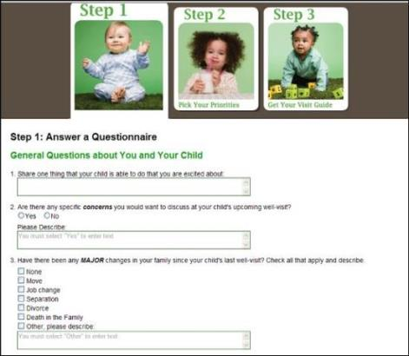
Step 1: The WVP questionnaire
Well-visits are the perfect time to help your child's health care provider get to know your child and your family.
The WVP asks questions about:
what your child is learning to do
(Children develop at different
rates, so your child may not be able
to do all of these things!)
what concerns you might have
what is going on in your family that might affect your child's health

Slide 11
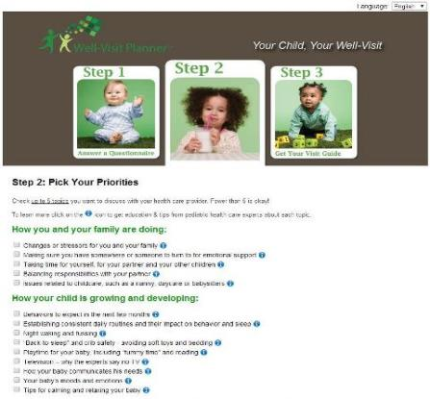
Step 2: Pick what’s important to you
There are many things that could be discussed at a well-visit. Not all of them are important to you right now!
Step 2 of the WVP will help you think about the important topics you'd most like to discuss.
Each item on the list has more information if you click on the blue “i” - this may answer some of your questions ahead of time.

Slide 12
Step 3: Get your Visit Guide
Once you have completed the questionnaire, you'll see your personalized Visit Guide that you can print and bring with you to share with your provider. If you don’t have a printer, ask your provider if you can email your Guide to them!

Slide 13
Your child, your well-visit.
www.wellvisitplanner.org
Developed by The Child and Adolescent Health Measurement Initiative (CAHMI) www.cahmi.org
info@cahmi.org

